Slide 1
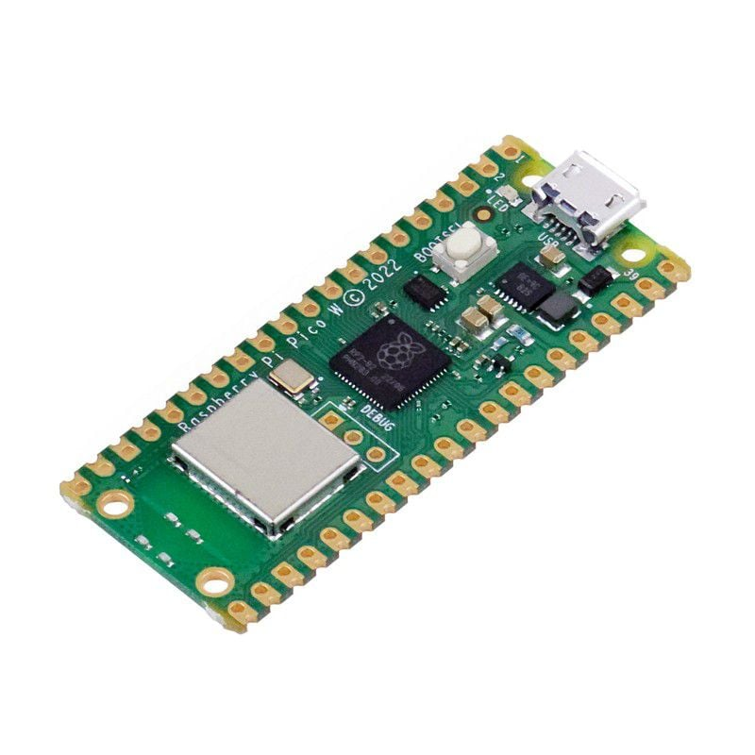

RASPBERRY PI PICO W
INTRODUCTION TO CIRCUITPYTHON

Slide 2
OVERVIEW
CircuitPython in a Glance
Programming language based on Python, designed for microcontrollers and small computing devices.
CircuitPython
Language: uses a subset of the Python programming language.
Ease of Use: beginner-friendly. It typically involves a simpler setup, and users can get started quickly without much prior knowledge of programming or electronics.
Platform Support: microcontrollers such as those from Adafruit, and it may be limited in terms of hardware support compared to Arduino.
Interactive Development: Users can connect to the board via USB and edit code directly on the device without needing additional hardware.
No Compilation Required: Code is interpreted rather than compiled, which simplifies the development process for beginners.

Slide 3
OVERVIEW
Arduino
Language: C/C++ derivative. While it might have a steeper learning curve for beginners, it provides more control for those familiar with these languages.
Community and Ecosystem: Large and active community, resulting in extensive documentation, libraries, and community support. This can be advantageous when troubleshooting or seeking help.
Versatility: Supports a wide range of microcontroller boards, offering more versatility in terms of hardware options.
Performance: Arduino code is compiled, which can lead to more optimized and potentially faster code execution compared to interpreted languages like CircuitPython.
Traditional Development Process: Typically involves a more traditional development process where code is written, compiled, and uploaded to the board. This might be less intuitive for beginners.

Slide 4
OVERVIEW
Choosing Between CircuitPython and Arduino
Skill Level
For beginners or those with a preference for Python, CircuitPython may be more accessible.
Those with a background in C/C++ might find Arduino more comfortable.
Project Requirements
If a specific microcontroller or a wide range of hardware options is crucial, Arduino might be a better fit.
If simplicity and ease of use are priorities, especially for educational or quick prototyping purposes, CircuitPython may be preferred.
Community and Resources
The abundance of resources and a supportive community can be a significant factor. Arduino's larger user base often results in more available libraries, examples, and troubleshooting help.

Slide 5


Slide 6
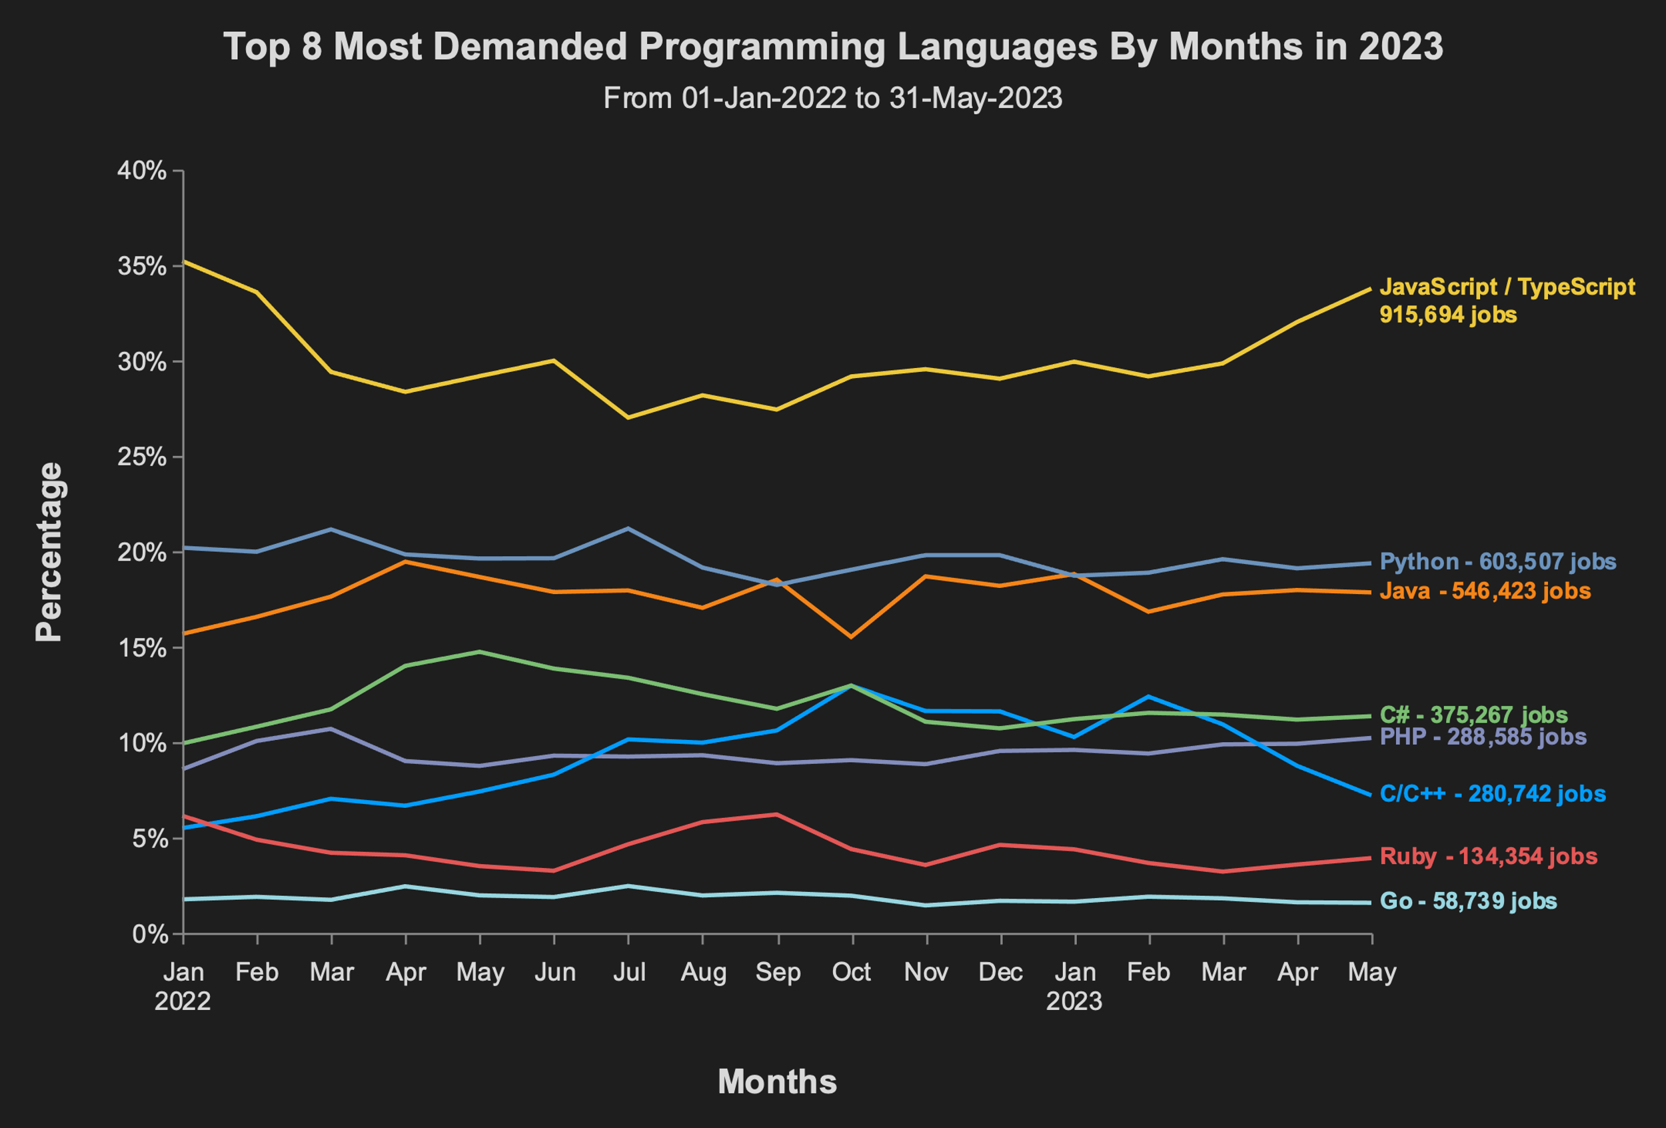

Slide 7
AGENDA
1
Installation Process
2
Diagram pinout PICO W
3
Digital Input/Output
LED blinking
Push button
Buzzer
4
Analog Input/Output
DHT sensor
Ultrasonic sensor
LDR sensor
PIR sensor

Slide 8
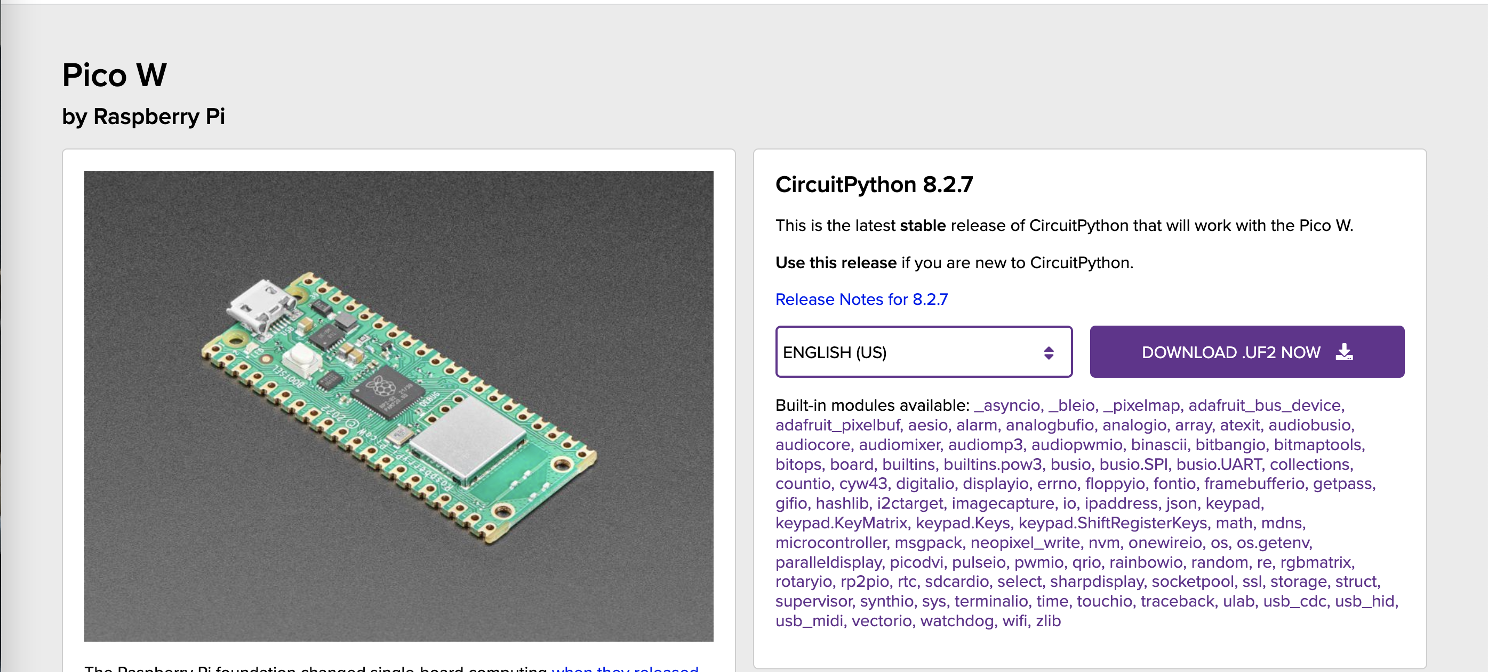
INSTALLATION PROCESS
Download CircuitPython firmware UF2 from https://circuitpython.org/board/raspberry_pi_pico_w/
E.g., Firmware name: adafruit-circuitpython-raspberry_pi_pico_w-en_US-8.2.7.uf2
UF2 is a file format, developed by Microsoft for PXT (also known as Microsoft MakeCode), that is particularly suitable for flashing microcontrollers over MSC (Mass Storage Class; aka removable flash drive)

Slide 9
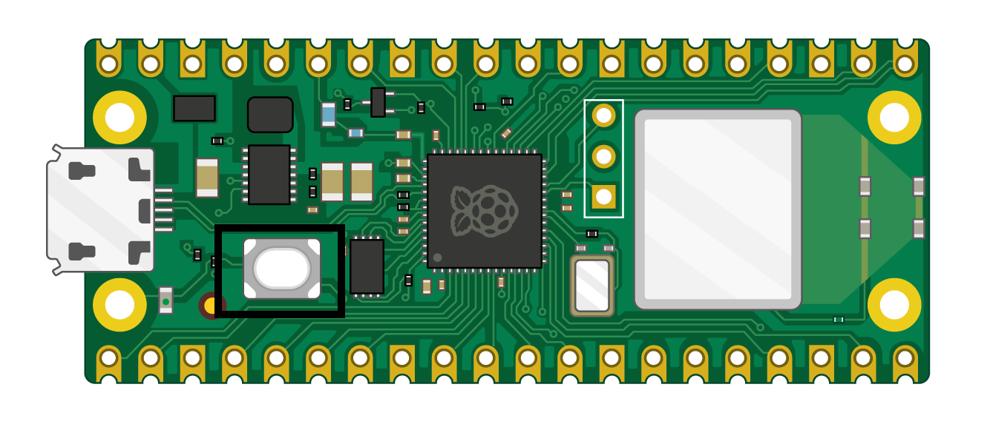
INSTALLATION PROCESS
Firmware installation
Press Reset button while connect USB cable to the laptop.
Now drag and paste the downloaded firmware into Pico W device (adafruit-circuitpython-raspberry_pi_pico_w-en_US-8.2.7.uf2)
Wait until the the firmware is completely transferred into Pico
Release the Reset button

Slide 10
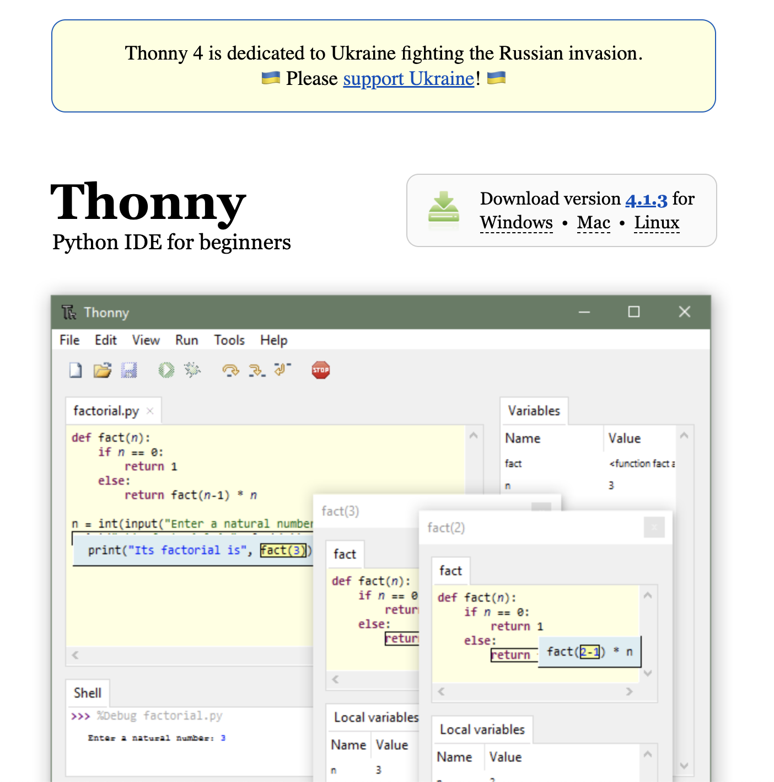
INSTALLATION PROCESS
IDE installation
Navigate to https://thonny.org/
Select version that support laptop’s OS i.e., Windows for windows users.
Make sure to follow along the installation procedure until complete

Slide 11
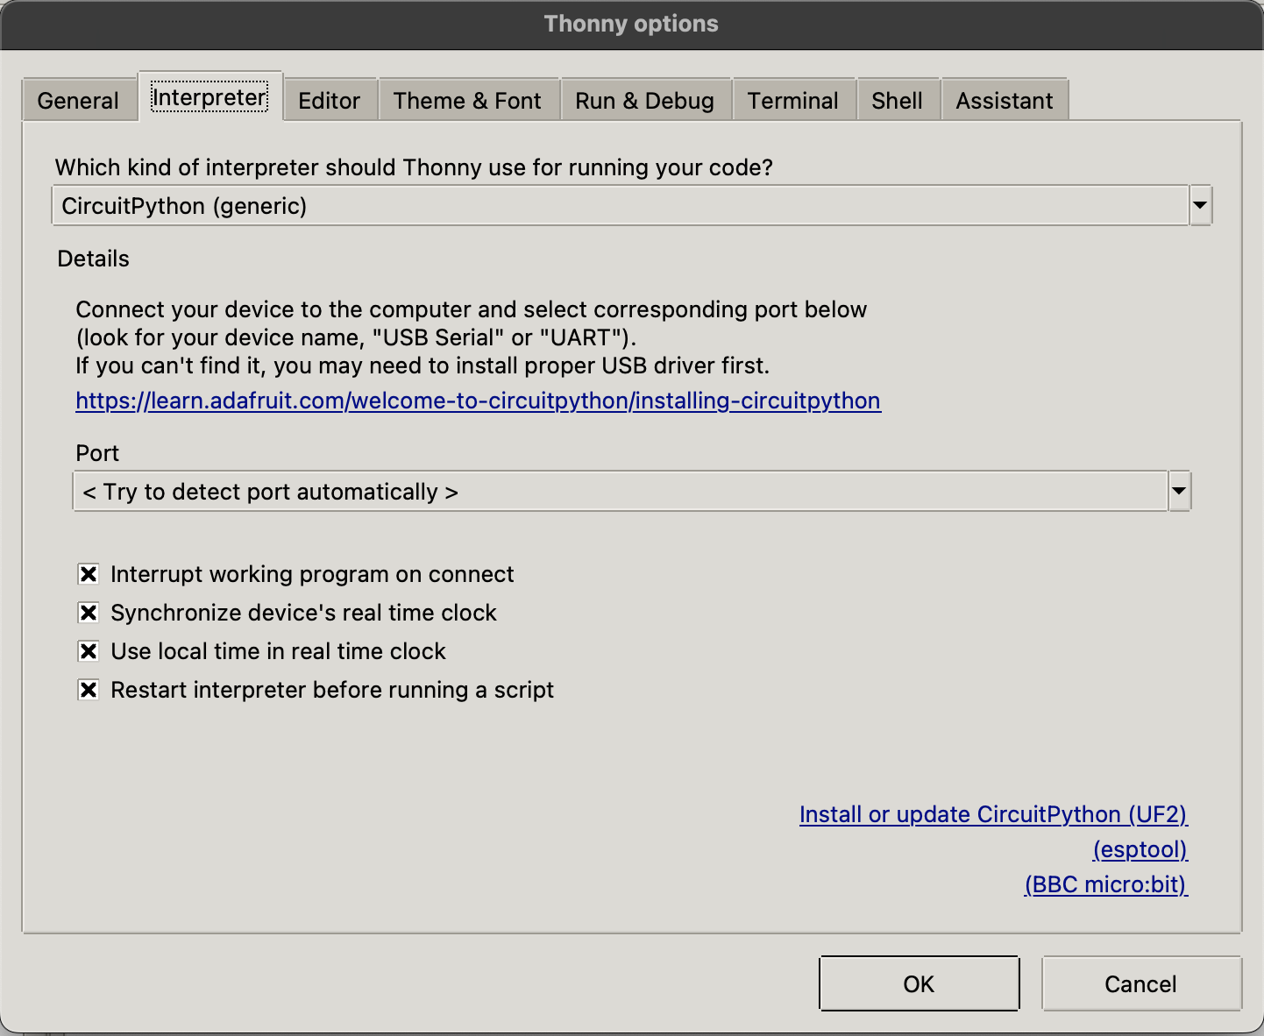
GETTING STARTED WITH THONNY IDE
Connect Pico-W to your Laptop via USB Port.
Wait until green LED blink and launch Thonny IDE
Navigate to a Run tab and Select interpreter
Select CircuitPython (generic)
On the Port Selection, choose <Try to detect port automatically>
Click OK

Slide 12
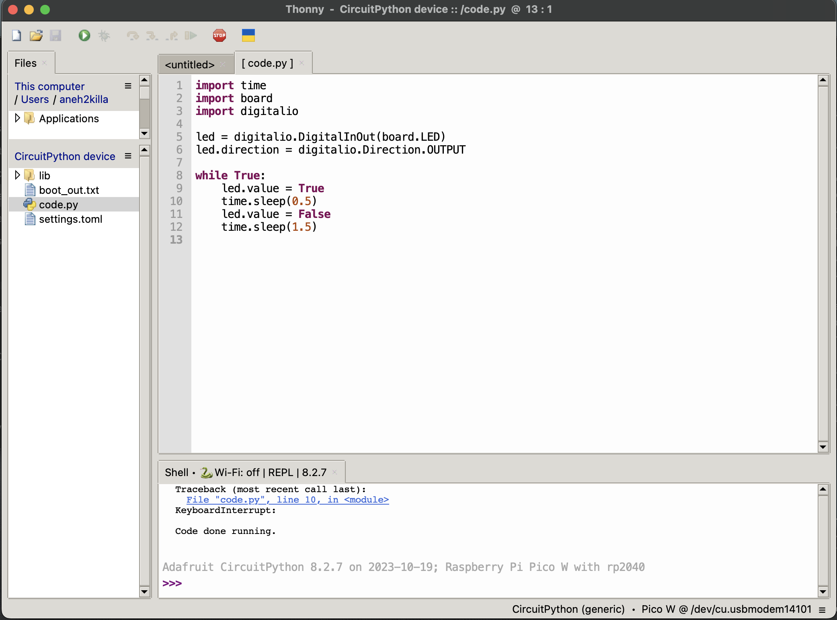
GETTING STARTED WITH THONNY IDE
Check the connectivity status
If not connected, check the previous step
If the connection is ok, it says something like:
Code done running...

Slide 13
GETTING STARTED WITH THONNY IDE
Navigate to View tab
Select Files
Double click on code.py to start coding
Now on the code window write the following lines

Slide 14
GETTING STARTED WITH THONNY IDE
Navigate to View tab
Select Files
Double click on code.py to start coding
Now on the code window write the following lines
Once complete, click RUN button

Slide 15
GETTING STARTED WITH THONNY IDE
To edit the code, you need to stop the running program by clicking on STOP button

Slide 16
GETTING STARTED WITH THONNY IDE
Observe the LED status
To edit the code, first STOP the running program
Then modify the code and once completed, click RUN again

Slide 17
UNDERSTANDING THE LOGICS
import
Include any library to use with the program
while True
A loop that run the program repeatedly
True
Set an element to HIGH (ON state)
False
Set an element to LOW (OFF state)
time.sleep
Set a time for a task to run (in seconds)

Slide 18
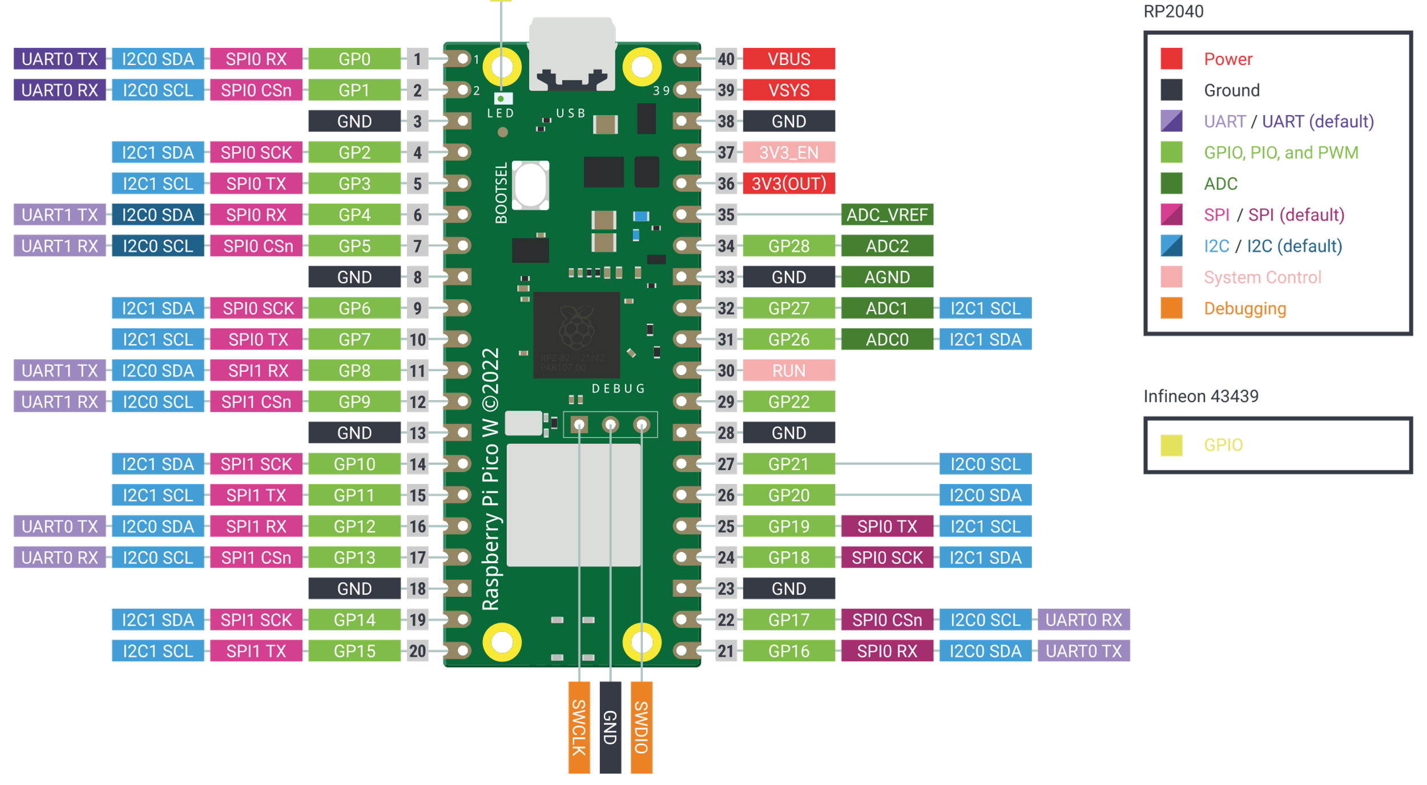
PICO W PINOUT

Slide 19
ADDING A LIBRARY IN THONNY IDE
Normally, a task requires a specific library to be functional
Complex or high-level tasks often demand the integration of specific libraries to ensure smooth execution.
Note that different versions of a library are tailored for distinct IDE versions or firmware versions on devices like the Pico. This ensures compatibility and optimal performance across varying software and hardware environments.
Let's demonstrate how a library is added.

Slide 20
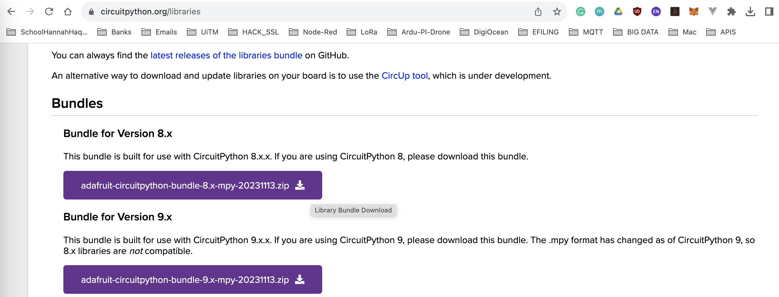
ADDING A LIBRARY IN THONNY IDE
Navigate to https://circuitpython.org/libraries
Select a version named: “adafruit-circuitpython-bundle-8.x-mpy-20231110.zip”

Slide 21
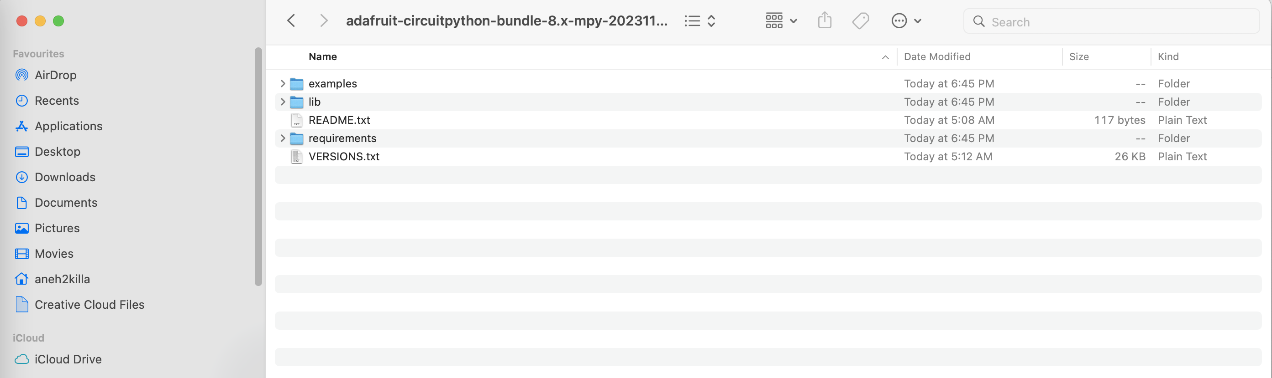
ADDING A LIBRARY IN THONNY IDE
Decompress the downloaded zip file and navigate into the folder location a sub folder named lib

Slide 22
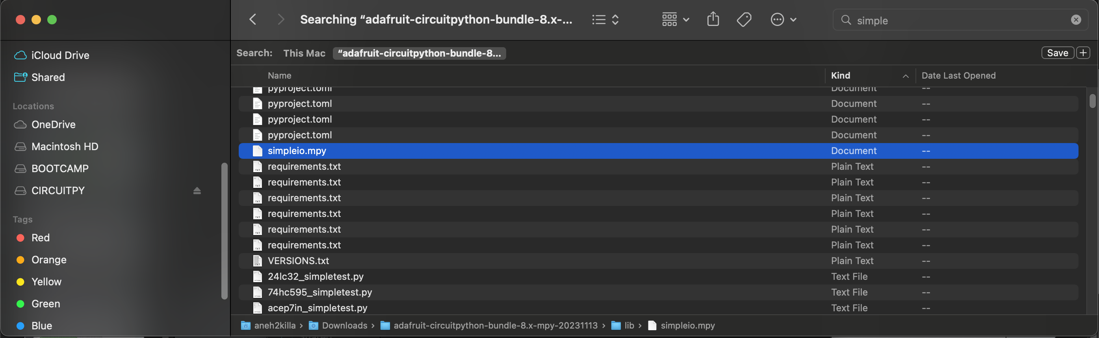
ADDING A LIBRARY IN THONNY IDE
To include a library into Pico W, simple drag and drop a xxx.mpy into the device named CIRCUITPY

Slide 23
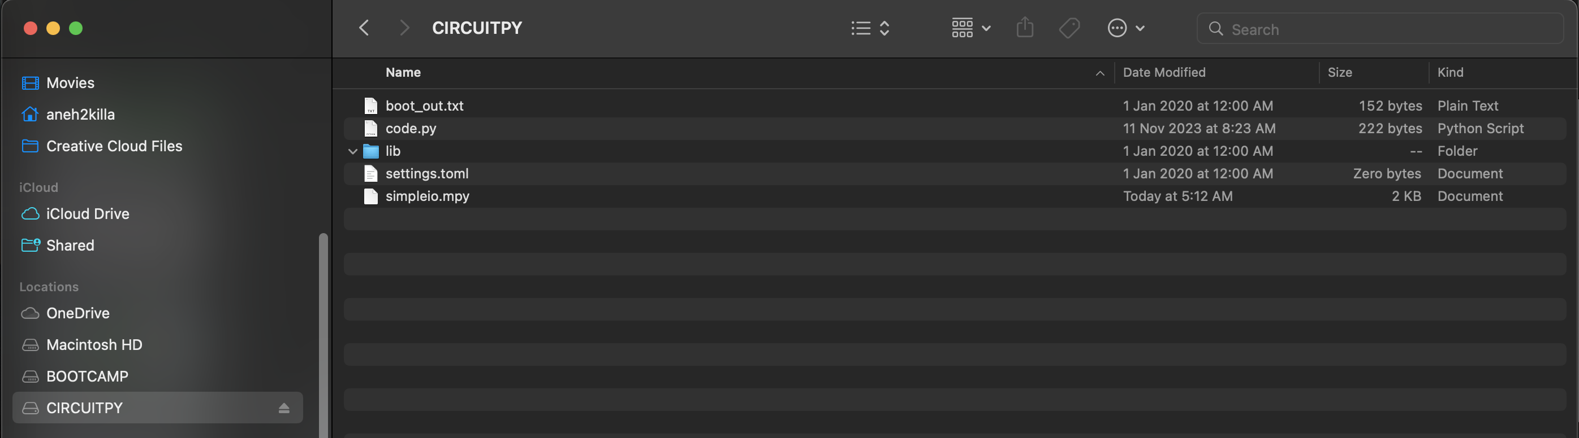
ADDING A LIBRARY IN THONNY IDE
Now click on CIRCUITPY, you will notice the xxx.mpy is available in Pico W

Slide 24
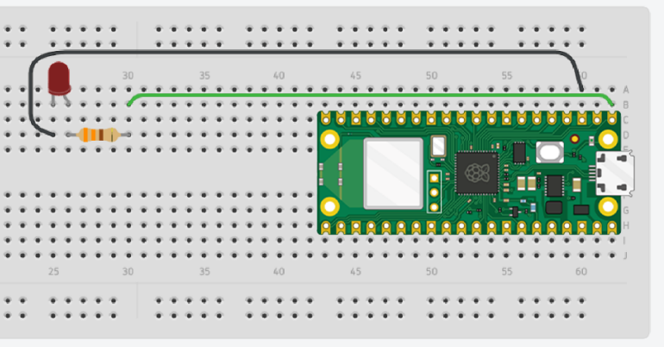
BLINK AN EXTERNAL LED
Required Components
Breadboard
Jumper Wires
1 x LED
1 x 330Ω Resistor
import time
import board
import digitalio
led = digitalio.DigitalInOut(board.GP0)
led.direction = digitalio.Direction.OUTPUT
while True:
led.value = True
time.sleep(0.5)
led.value = False
time.sleep(1)
BLINK LED LINK

Slide 25
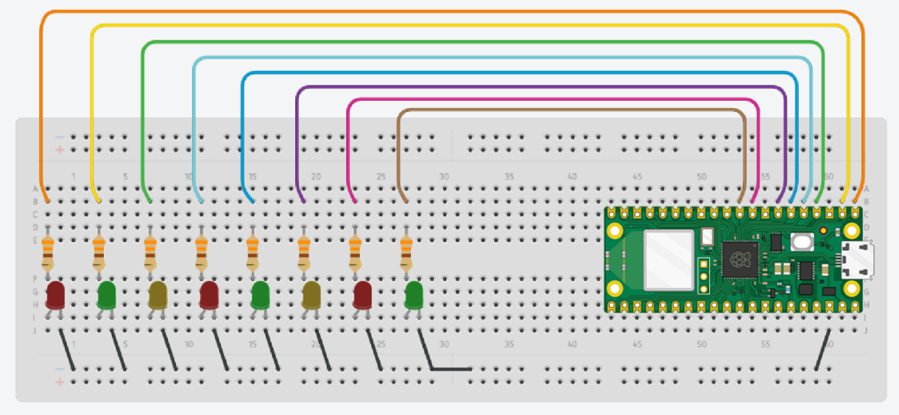
BLINK AN EXTERNAL LED
Required components
Jumper Wires
8 x LEDs
8 x 330Ω Resistor
Please refer the code in this link: MULTIPLE LED LINK

Slide 26
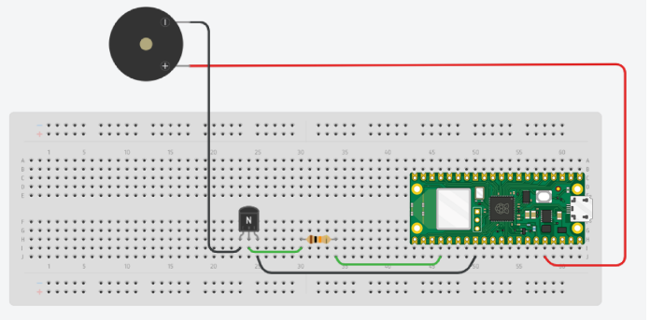
DIGITAL OUTPUT:BUZZER
This project is about how to use a piezo buzzer with Raspberry Pi Pico W
Required components
Jumper Wires
Buzzer
1 x 2N2222 Transistor
1 x 10kΩ Resistor
Wiring connection
+ buzzer - 3.3v
Transistor C - G buzzer
Transistor B - Resistor
Resistor – GP18
Please refer the code in this link: BUZZER CODE LINK
REQUIRED LIB: simpleio.mpy

Slide 27
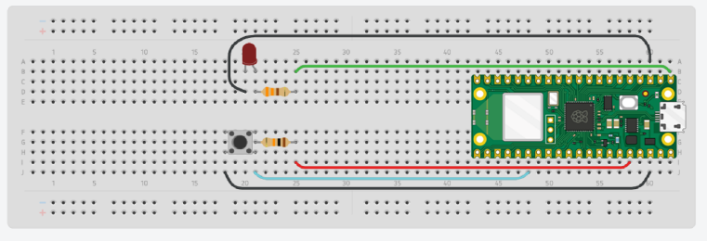
DIGITAL INPUT: PUSH BUTTON
Required component
Breadboard
Jumper Wires
1 x LED
1 x Push Button
1 x 330Ω Resistor
1 x 10kΩ Resistor
Wiring connection
LED – GP0
Push button – gp20
Please refer the code in this link: PUSH BUTTON LINK

Slide 28
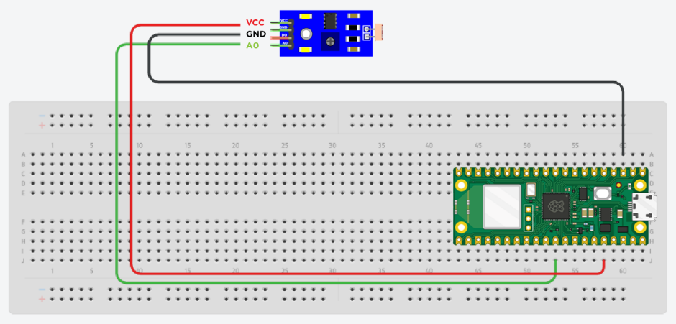
ANALOG INPUT: LDR
Required component
Breadboard
Jumper Wires
LDR
Wiring Connection
Vcc – 3.3V
Gnd – Ground
A0 – GP 26
Please refer the code in this link: LDR LINK

Slide 29
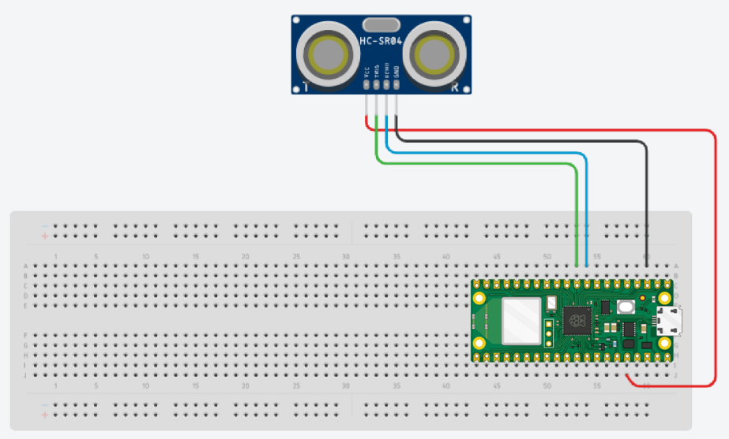
ANALOG INPUT: ULTRASONIC
Required component
Breadboard
Jumper Wires
HC-SR04 Ultrasonic Sensor
Wiring Connection
Vcc – 3.3V
Gnd – Ground
Trig – GP7
Echo – GP 6
Please refer the code in this link: ULTRASONIC LINK
REQUIRED LIB: adafruit_hcsr04.mpy

Slide 30
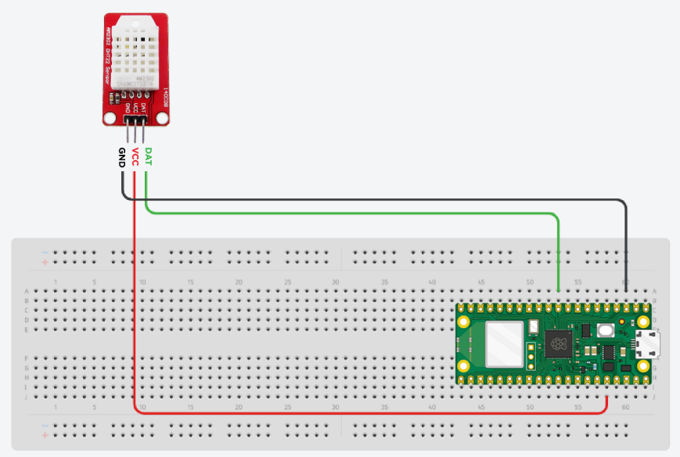
ANALOG INPUT: DHT THERMAL SENSOR
Required component
Breadboard
Jumper Wires
DHT22
Wiring Connection
Vcc – 3.3V
Gnd – Ground
A0 – GP27
Please refer the code in this link: DHT LINK
REQUIRED LIB: adafruit_dht.mpy

Slide 31
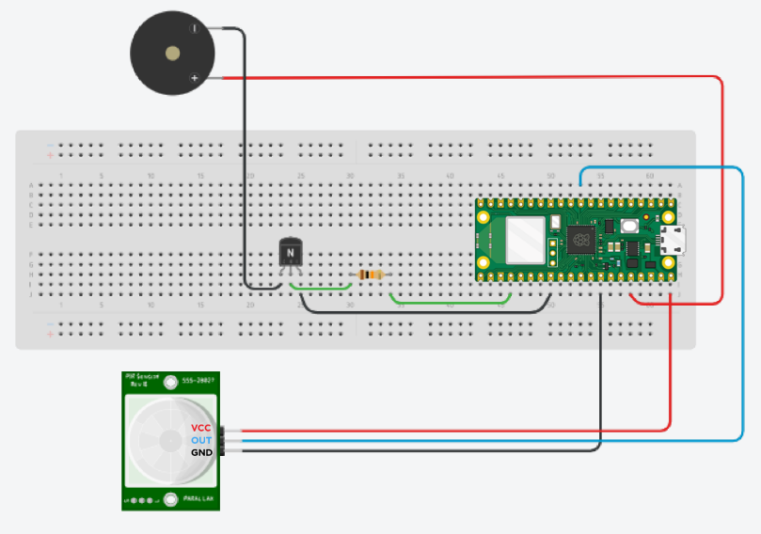
ANALOG INPUT AND OUTPUT
Required component
Jumper Wires
Buzzer
PIR Sensor
1 x 2N2222 Transistor
1 x Resistor 10kΩ Resistor
Wiring connection
+ buzzer - 3.3v
Transistor C - G buzzer
Transistor B - Resistor
Resistor – GP18
PIR
VCC – VBUS
OUT – GP27
GND - GND
Please refer the code in this link: PIR LINK
REQUIRED LIB: simpleio.mpy

Slide 32
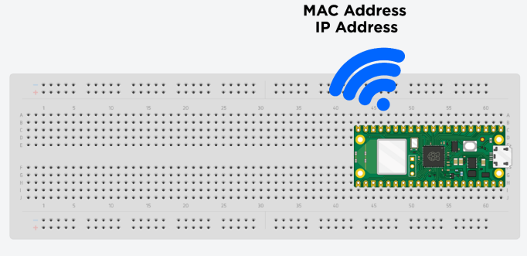
INTRODUCTION NETWORK
Require component
Raspberry Pi Pico W
Micro USB Cable
Breadboard
Please refer the code in this link WIFI LINK

Slide 33
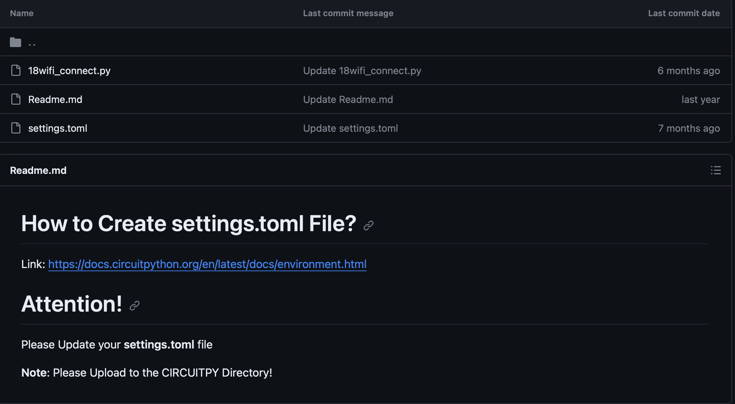
INTRODUCTION NETWORK AND IOT
Require component
Raspberry Pi Pico W
Micro USB Cable
Breadboard
Please refer the code in this link WIFI LINK

Slide 34
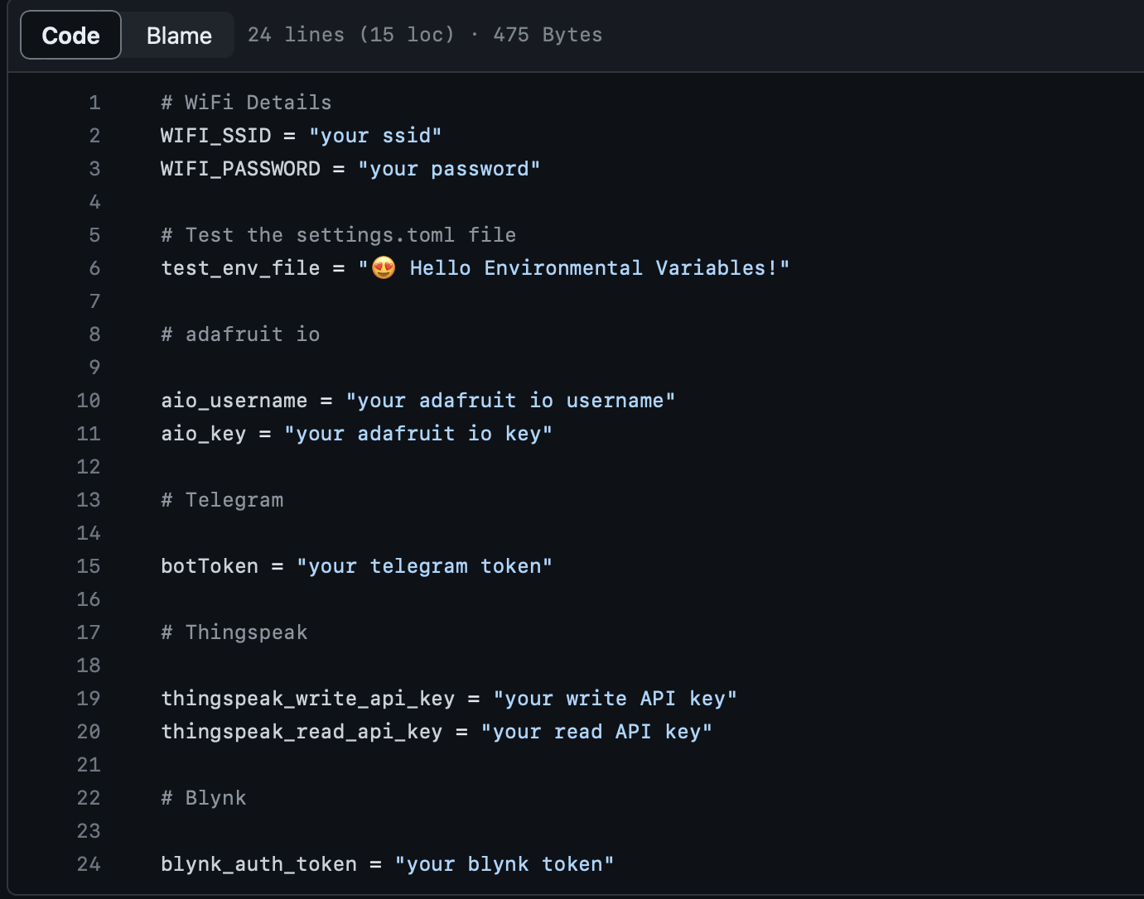
INTRODUCTION NETWORK AND IOT
Require component
Raspberry Pi Pico W
Micro USB Cable
Breadboard
Please refer the code in this link WIFI LINK

